Slide 1
Recursive and Recursively Enumerable Languages
S.Rajkumar
Assistant Professor
SCSE, VIT University
Vellore.

Slide 2
Definition:
A language is recursively enumerable
if some Turing machine accepts it
1

Slide 3





Let be a recursively enumerable language
and the Turing Machine that accepts it
For string :
if
then halts in a final state
if
then halts in a non-final state
or loops forever

Slide 4
Definition:
A language is recursive
if some Turing machine accepts it
and halts on any input string
In other words:
A language is recursive if there is
a membership algorithm for it

Slide 5
Let be a recursive language
and the Turing Machine that accepts it
For string :
if
then halts in a final state
if
then halts in a non-final state

Slide 6
We will prove:
1. There is a specific language
which is not recursively enumerable
(not accepted by any Turing Machine)
2. There is a specific language
which is recursively enumerable
but not recursive

Slide 7
Non Recursively Enumerable
Recursively Enumerable
Recursive

Slide 8
A Language which is not
Recursively Enumerable

Slide 9
We want to find a language that
is not Recursively Enumerable
This language is not accepted by any
Turing Machine

Slide 10
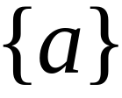

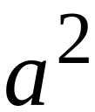
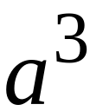
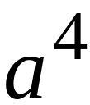
Consider alphabet
Strings:

Slide 11
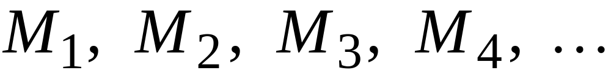
Consider Turing Machines
that accept languages over alphabet
They are countable:

Slide 12
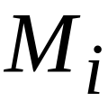
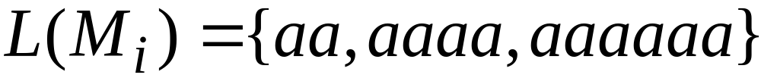
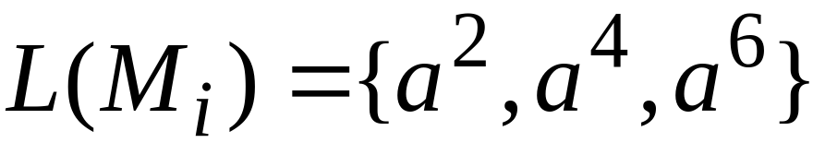







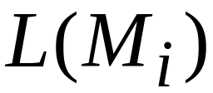


Example language accepted by
Alternative representation

Slide 13
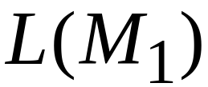
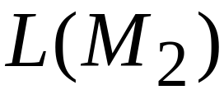
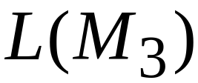
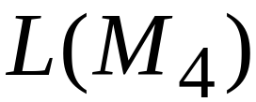

Slide 14
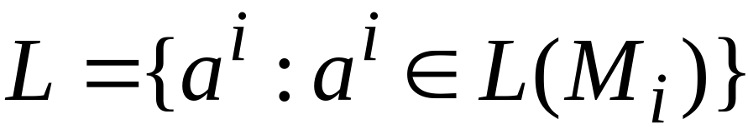
Consider the language
consists from the 1’s in the diagonal

Slide 15
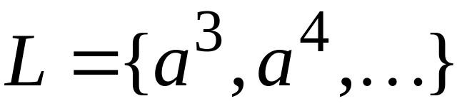

Slide 16

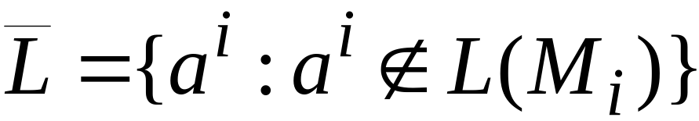

Consider the language
consists of the 0’s in the diagonal

Slide 17
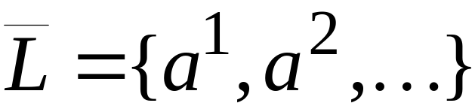

Slide 18
Theorem:
Language is not recursively enumerable

Slide 19
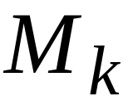
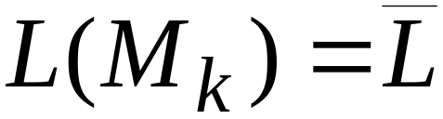
Proof:
Assume for contradiction that
is recursively enumerable
There must exist some machine
that accepts

Slide 20
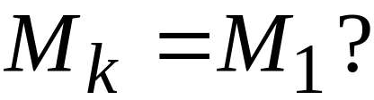
Question:

Slide 21
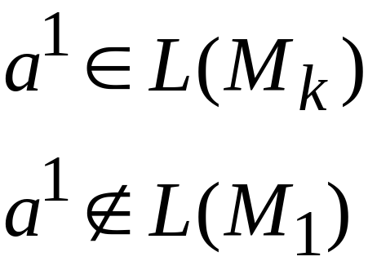
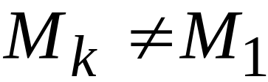
Answer:

Slide 22
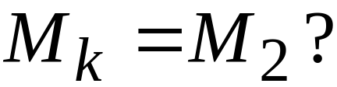
Question:

Slide 23
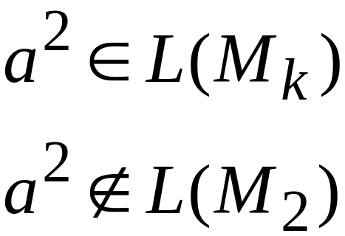
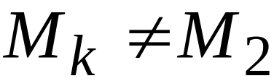
Answer:

Slide 24
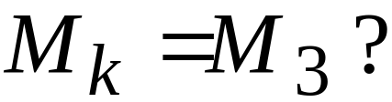
Question:

Slide 25
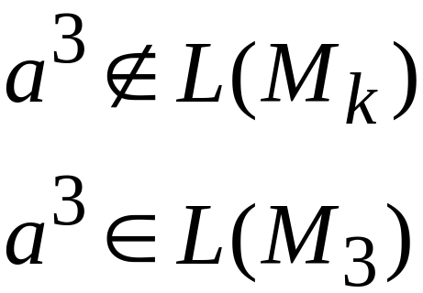
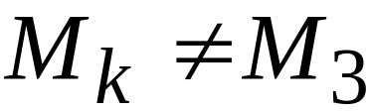
Answer:

Slide 26
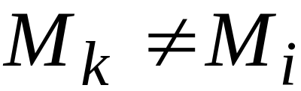

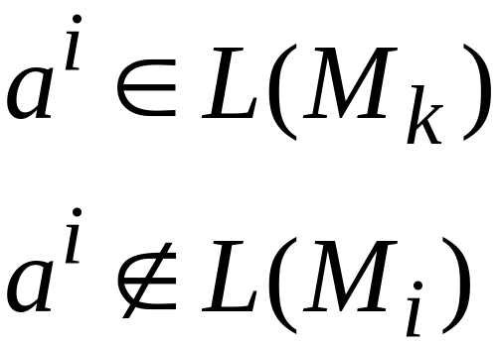
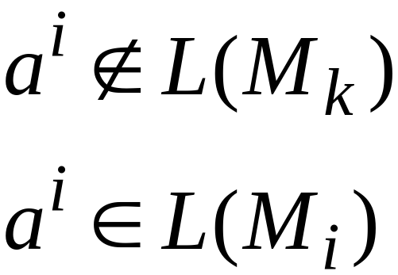
Similarly:
for any
Because either:
or

Slide 27
Therefore, the machine cannot exist
Therefore, the language
is not recursively enumerable
End of Proof

Slide 28
Observation:
There is no algorithm that describes
(otherwise would be accepted by
some Turing Machine)

Slide 29
Non Recursively Enumerable
Recursively Enumerable
Recursive

Slide 30
A Language which is
Recursively Enumerable and not Recursive

Slide 31
We want to find a language which
Is recursively
enumerable
But not
recursive
There is a
Turing Machine
that accepts
the language
The machine
doesn’t halt
on some input

Slide 32
We will prove that the language
Is recursively enumerable
but not recursive

Slide 34
Theorem:
The language
is recursively enumerable

Slide 35
Proof:
We will give a Turing Machine that
accepts

Slide 36
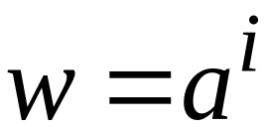

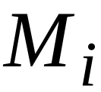

Turing Machine that accepts
For any input string
Compute , for which
Find Turing machine
(using an enumeration procedure
for Turing Machines)
Simulate on input
If accepts, then accept
End of Proof

Slide 37
Observation:
Recursively enumerable
Not recursively enumerable
(Thus, also not recursive)

Slide 38
Theorem:
The language
is not recursive

Slide 39
Proof:
Assume for contradiction that is recursive
Then is recursive:
Take the Turing Machine that accepts
halts on any input:
If accepts then reject
If rejects then accept

Slide 40
Therefore:
is recursive
But we know:
is not recursively enumerable
thus, not recursive
CONTRADICTION!!!!

Slide 41
Therefore, is not recursive
End of Proof

Slide 42
Non Recursively Enumerable
Recursively Enumerable
Recursive

Slide 43
Turing acceptable languages and
Enumeration Procedures

Slide 44
We will prove:
(weak result)
If a language is recursive then
there is an enumeration procedure for it
(strong result)
A language is recursively enumerable
if and only if
there is an enumeration procedure for it

Slide 45

Theorem:
if a language is recursive then
there is an enumeration procedure for it

Slide 46
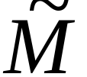
Proof:
Enumeration Machine
Enumerates all
strings of input alphabet
Accepts

Slide 47
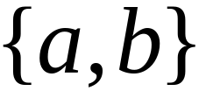









If the alphabet is then
can enumerate strings as follows:

Slide 48
Enumeration procedure
Repeat:
generates a string
checks if
YES: print to output
NO: ignore
End of Proof

Slide 49
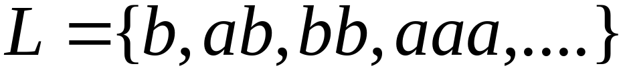
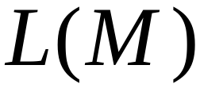
Example:
Enumeration
Output

Slide 50
Theorem:
if language is recursively enumerable then
there is an enumeration procedure for it

Slide 51

Proof:
Enumeration Machine
Enumerates all
strings of input alphabet
Accepts

Slide 52
If the alphabet is then
can enumerate strings as follows:

Slide 53
NAIVE APPROACH
Enumeration procedure
Repeat:
generates a string
checks if
YES: print to output
NO: ignore
Problem:
If
machine may loop forever

Slide 54
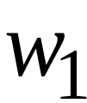
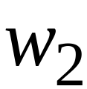
BETTER APPROACH
Generates first string
executes first step on
Generates second string
executes first step on
second step on

Slide 55
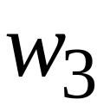
Generates third string
executes first step on
second step on
third step on
And so on............

Slide 56
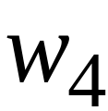
1
1
1
1
Step
in
string
2
2
2
2
3
3
3
3

Slide 57

If for any string
machine halts in a final state
then it prints on the output
End of Proof

Slide 58
Theorem:
If for language
there is an enumeration procedure
then is recursively enumerable

Slide 59
Proof:
Input Tape
Machine that
accepts
Enumerator
for
Compare

Slide 60
Turing machine that accepts
For input string
Repeat:
Using the enumerator,
generate the next string of
Compare generated string with
If same, accept and exit loop
End of Proof

Slide 61
We have proven:
A language is recursively enumerable
if and only if
there is an enumeration procedure for it

